Slide 1
Spring MicroServices

Slide 2
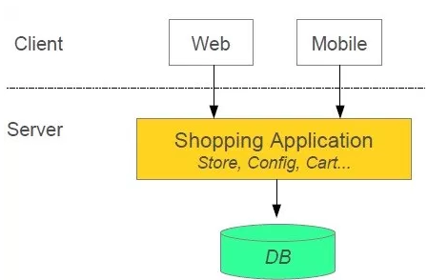
Shopping System without MicroService
In this architecture we are using Monolith architecture i.e. all collaborating components combine all in one application.
https://www.edureka.co/blog/what-is-microservices/

Slide 3
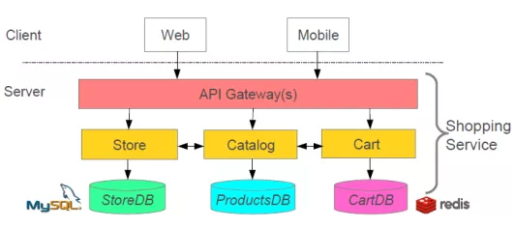
Advantages of MicroServices
Loose Coupling– Application build from collaboration services or processes, so any process change without effecting another processes.
Tight Cohesion-An individual service or process that deals with a single view of data.

Slide 4
What is MicroServices
The main objective of the micro-services implementation is to split up the application as separate service for each core and API service functionality and it should be deployed independently.
Microservices architecture allows to avoid monolith application for large system. It provide loose coupling between collaborating processes which running independently in different environments with tight cohesion.
Why MicroServices are Preferred?
We chose micro services architecture to write each functionality as a separate service for core and API functionality and it helps us to achieve the continuous delivery and integration.

Slide 5
Disadvantages of Monolithic System
Monolithic app services tend to get tightly coupled and entangled as the application evolves, making it difficult to isolate services for purposes such as independent scaling or code maintainability.
Monolithic architectures are also much harder to understand, because there may be dependencies, side-effects, and magic which are not obvious when you’re looking at a particular service or controller.
Interdependenies with other Team/s

Slide 6
Microservice Architecture Patterns
https://microservices.io/patterns/microservices.html
https://microservices.io/patterns/data/saga.html

Slide 7
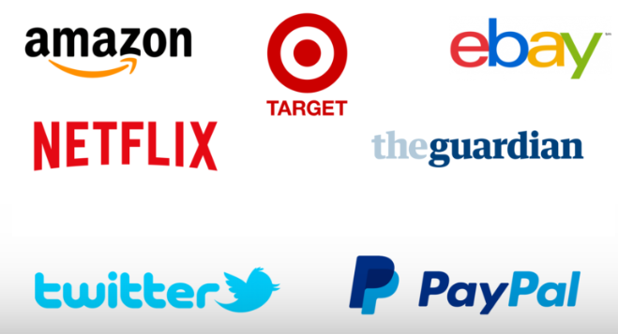
Organizations using Microservice Architecture

Slide 8
Organizations using Microservice Architecture
Some of the Tech giants shifted from Monolithic to Microservice Architecture
Netflix
Amazon
Uber
eBay
SoundCloud
Karma, etc…
Netflix: Netflix is often regarded as one of the pioneers of the microservice movement.
Netflix made the decision to break their monolith into microservices back in 2009, when their struggles with a monolithic architecture was causing the tech giant to experience growing pains as well as regular server outages. Adopting a microservice architecture was one of the factors that led to Netflix’s phenomenal growth.
Amazon: “If you go back to 2001, the Amazon.com retail website was a large architectural monolith,”
Back then, Amazon also struggled with managing its rapidly growing online presence. Meeting fluctuating web traffic demands was one thing, but Brigham also explained that the company, “noticed that it took a long time for a code change to go from a developer check-in, to be running in production where customers could use it.”
Today, Amazon is perhaps the world’s most prominent advocate of microservices, with Amazon Web Services (AWS) providing the infrastructure needed for companies to launch and manage containers and microservices on the fly.

Slide 9
Organizations using Microservice Architecture
Back then, Amazon also struggled with managing its rapidly growing online presence. Meeting fluctuating web traffic demands was one thing, but Brigham also explained that the company, “noticed that it took a long time for a code change to go from a developer check-in, to be running in production where customers could use it.”
Today, Amazon is perhaps the world’s most prominent advocate of microservices, with Amazon Web Services (AWS) providing the infrastructure needed for companies to launch and manage containers and microservices on the fly.
Uber: Uber was initially developed to serve only within a City. Uber’s unified and tightly coupled codebase delivered many, if not all, of Uber’s core business processes, including connecting drivers with riders, billing, and payments. But as the business grew, they found it difficult to add new features and scale across the globe efficiently. Microservices were identified as the solution, and Uber is still going micro today.
eBay: According to the CTO of eBay, Steve Fisher, eBay utilizes more than 1,000 services with front-end services sending API calls and the back-end services executing tasks like shipping and administration.
Each development team at eBay is assigned their own set of services, and if a team wants to create a new service, they can access their specially built internal cloud portal to develop, test and deploy the service.

Slide 10
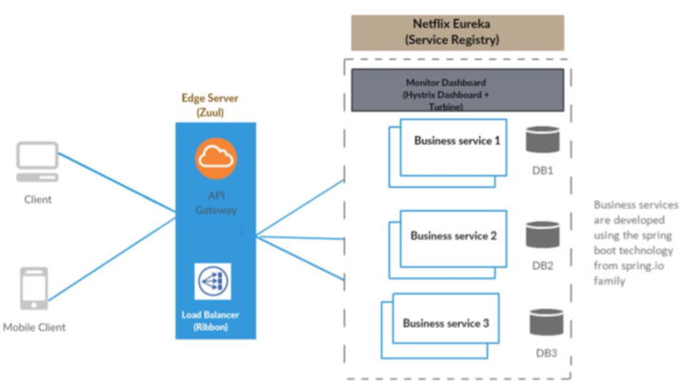
MicroServices Archietcture

Slide 11
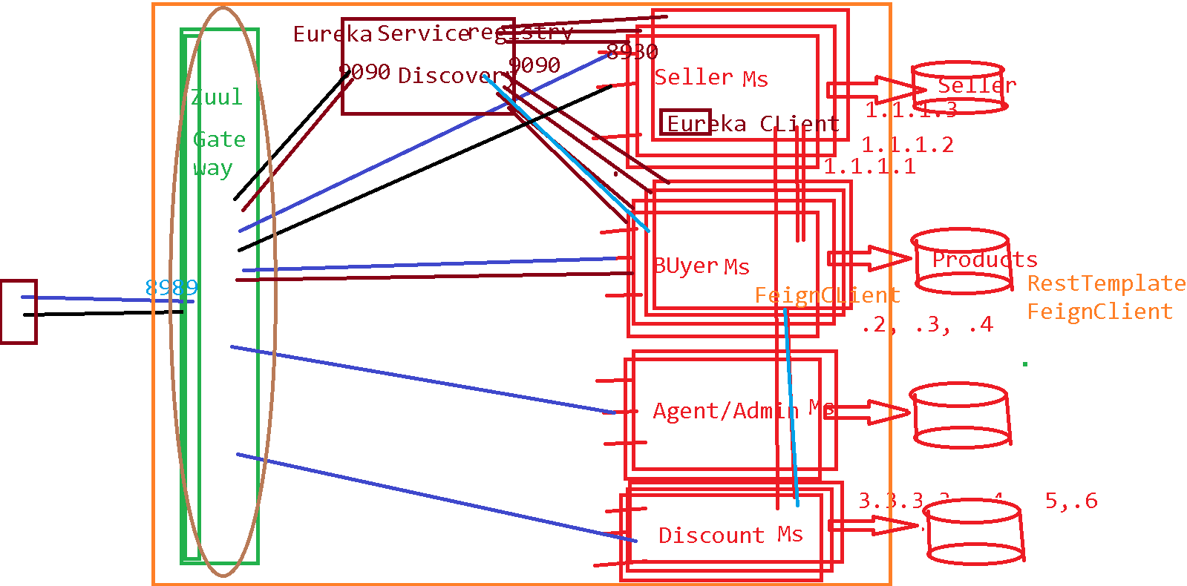

Slide 12
Advantages
Microservices Benefits
Smaller code base is easy to maintain.
Easy to scale as individual component. And each MicroService can be scaled differently, based on the load it expects.
Technology diversity i.e. we can mix libraries, languages, databases, frameworks etc. Polyglot
Fault isolation i.e. a process failure should not bring whole system down.
Better support for smaller and parallel team.
Independent deployment(catalysing Agile/Scrum Teams)
Ease for Developer as a Developer need not have entire code base on a single IDE, he/she need to develop/change/build code of his service
Build/Deployment time reduce
Decentralized Governance
Release Cycle of each Microservice can be different
In production, it is certainly not the case- we break monolithic applications into microservice applications because we can scale each service based on the payload. A single instance of a service is unimaginable in production- so what we generally do is use a load balancer, which balances the payload among multiple instances of a service.

Slide 13
MicroServices - Implementation
Using Spring for creating Microservices
Setup new service by using Spring Boot
Expose resources via a RestController
Consume other Microservice services using RestTemplate
Each Microservice has certain specific purpose, and they interact with each other to perform a required functionality.

Slide 14
MicroServices - Implementation
Microservices – Deployment, Registry & Discovery
Generally Microservices are installed in multiple Nodes, and each MicroService may have multiple instances. This is to provide Horizontal scalability.
The problem due to this is how one MicroService can detect another MicroService, and the system where it runs, and on which all instances a MicroService runs.
This is termed as Service Registry and Discovery, there is a tool named Eureka for Service Discovery.

Slide 15
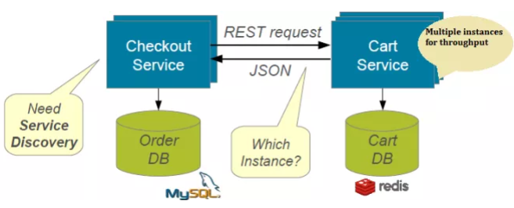
Without Discovery

Slide 16
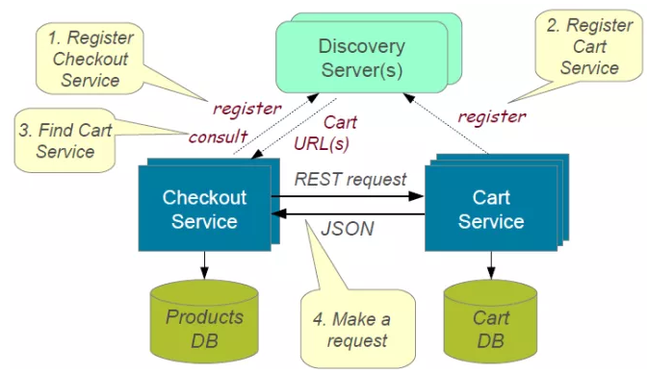
How Services Registry/Discovery works?

Slide 17
Advantages of Service Registry/Discovery
Microservices – Deployment, Registry & Discovery
Scalable - number of instances on which a Microservice can change, dynamically
Number of instances can change auto-scaling, failures, and Software/Hardware upgrades.
----
Eureka Client and Eureka Server(provided by Spring Cloud Netflix OSS) are used for Service Registry & Discovery

Slide 18
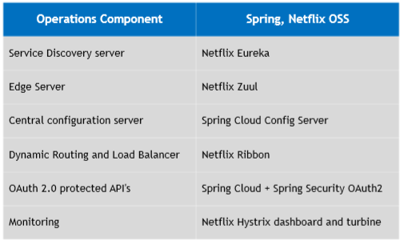
Netflix OSS Tools - MicroService Architecture
Below are Netflix OSS Tools used in MicroServices Architectures

Slide 19
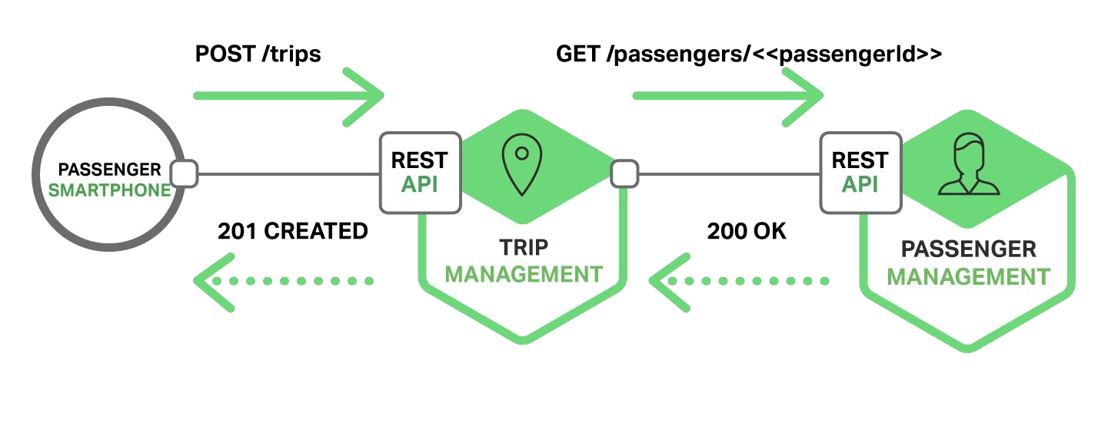
Traditional application
(without Service Registry/ Discovery)
To perform communication between services we need know the location of the service(port, host). In traditional applications it's a simple task because services run in a fixed and known location.

Slide 20
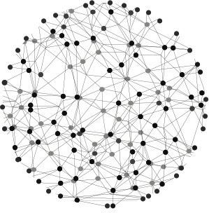
Modern application
In modern applications the services are running in a dynamic enviroment. A service can have N instances running in N different machines. In this case, to know host and port of each service manually is very painful.
Even though you know manually
that is subject to change, during run time.

Slide 21
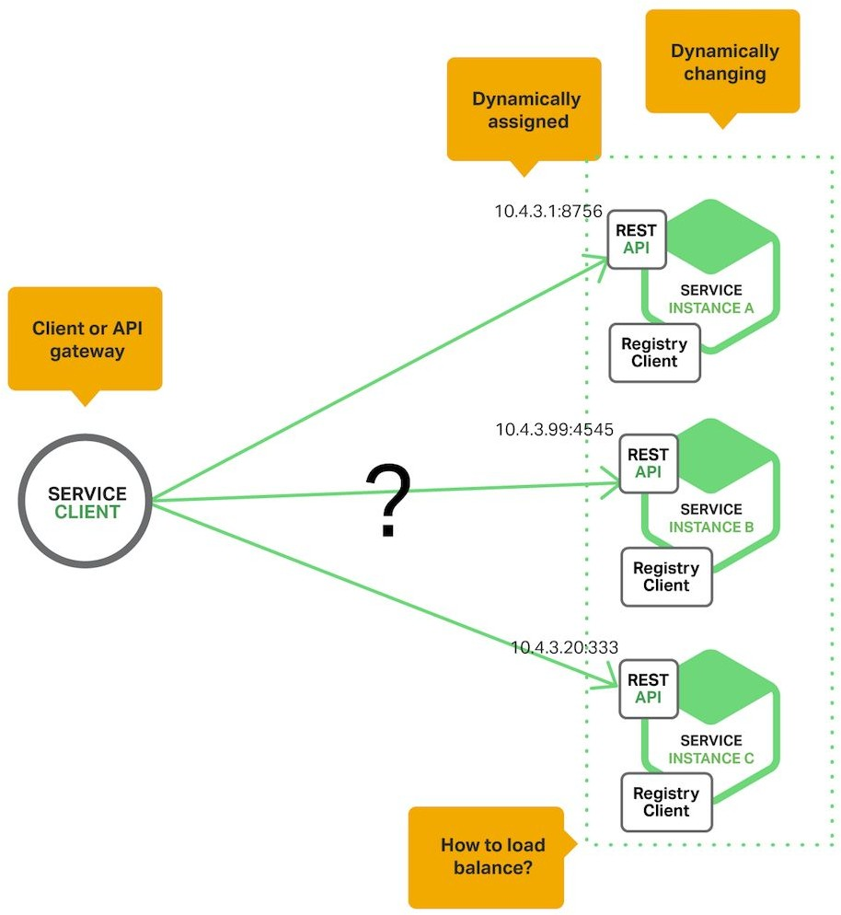
The problem

Slide 22
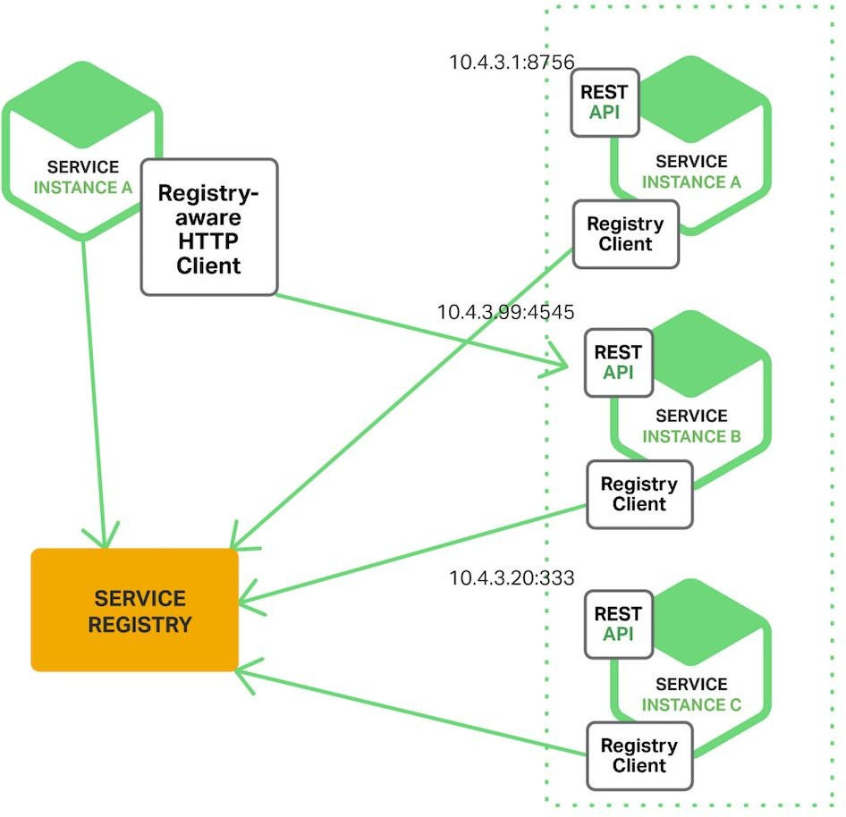
Service discovery

Slide 23
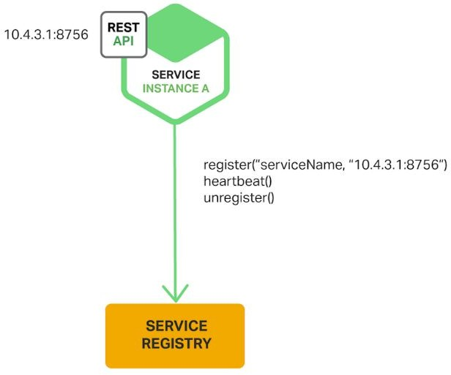
Service registry

Slide 24
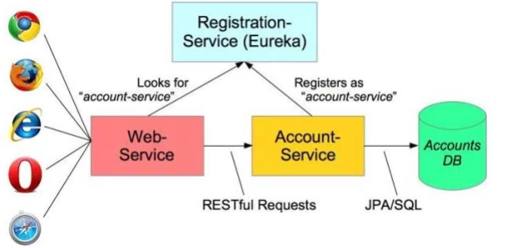
Eureka...
“Eureka is a REST (Representational State Transfer) based service that is primarily used in the AWS cloud for locating services for the purpose of load balancing and failover of middle-tier servers.”

Slide 25
Steps to use any Spring Cloud Tool
To add any Spring Cloud Tool, follow below steps
#1. add dependencies in pom.xml
#2. add required annotations in Java source code
#3. add required annotations to enable and use specific functionality in Java source code
#4. add required configurations in application.properties or application.yml file

Slide 26
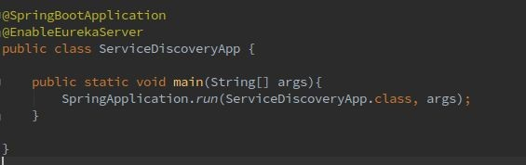
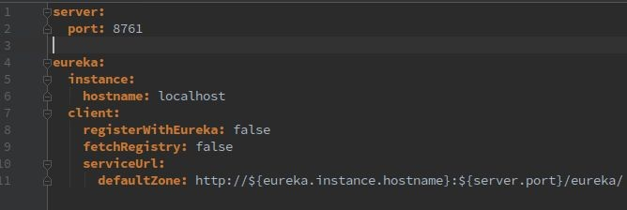
Eureka server with Spring Cloud configuration

Slide 27
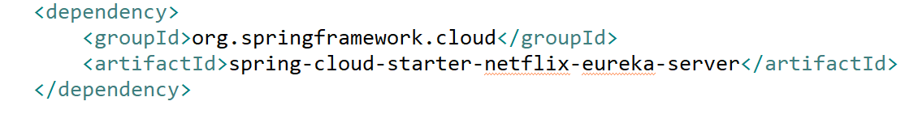
Add Eureka server in pom.xml

Slide 28
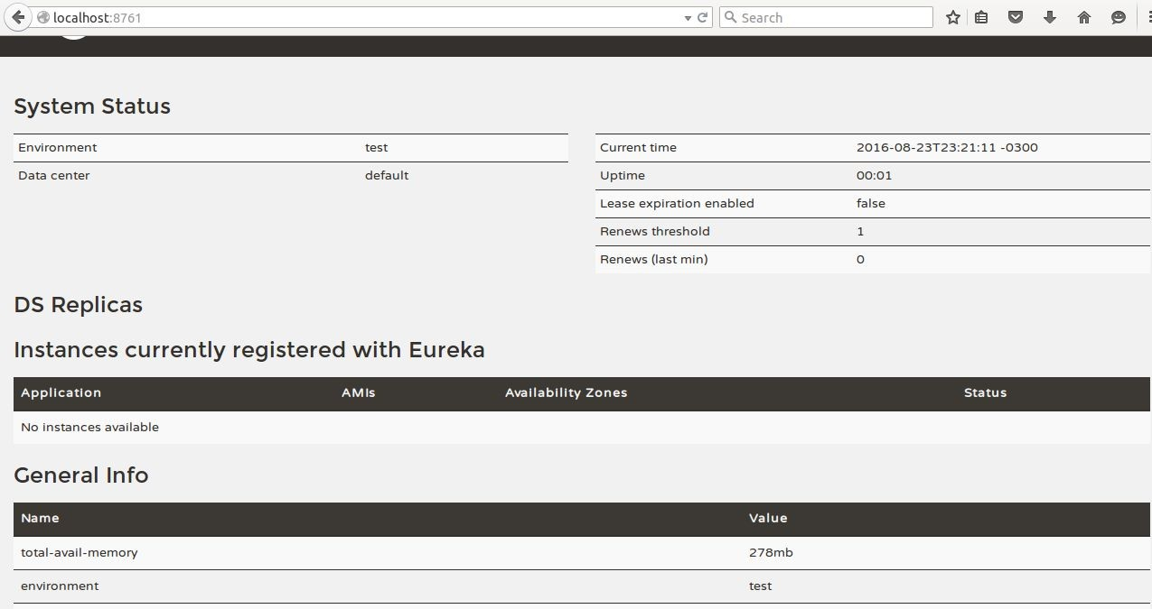
Eureka server dashboard

Slide 29
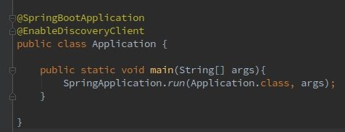
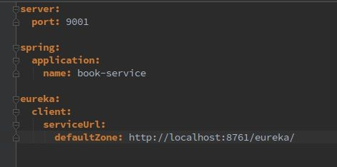
Eureka client configuration

Slide 30
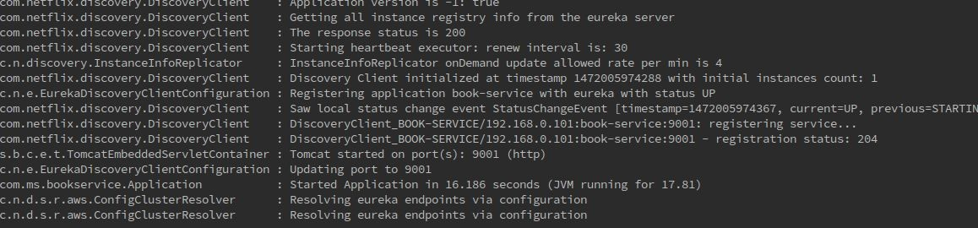
When you run the client application...

Slide 31
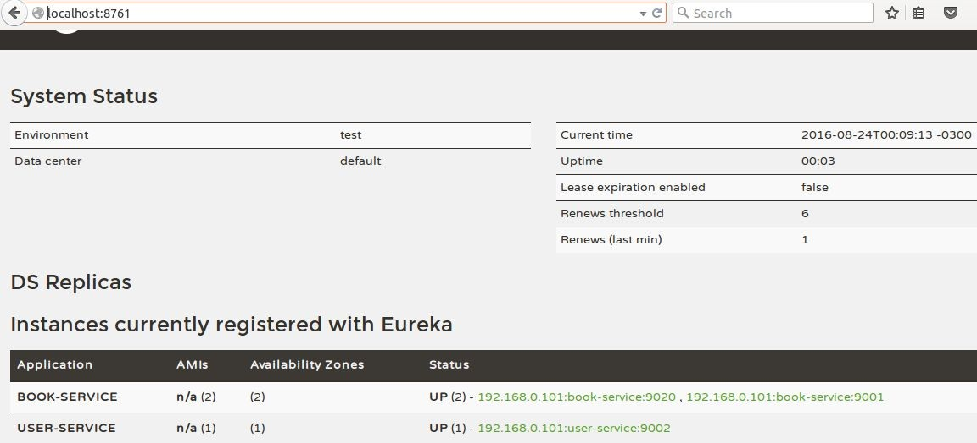
Eureka Dashboard
To view all instances registered
http://localhost:8761

Slide 32
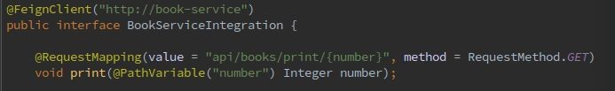
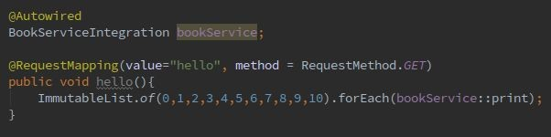
Consuming a service registered on Eureka
https://github.com/Netflix/eureka/wiki/Eureka-REST-operations

Slide 33
Microservices interaction -Feign Client
Netflix provides Feign as an abstraction over REST-based calls, by which microservices can communicate with each other, but developers don't have to bother about REST internal details.
Generally when one Service interacts with other Service(Eg. EmployeeService,) we programmatically construct the URL of the dependent microservice, then call the service using RestTemplate, so we need to be aware of the RestTemplate API to communicate with other microservices, which is certainly not part of our business logic.

Slide 34
Feign Client
Feign Client, which works on the declarative principle. We have to create an interface/contract, then Spring creates the original implementation on the fly, so a REST-based service call is abstracted from developers.
Not only that — if you want to customize the call, like encoding your request or decoding the response in a Custom Object, you can do it with Feign in a declarative way.
Feign, as a client, is an important tool for microservice developers to communicate with other microservices via Rest API.

Slide 35
Feign Client
Feign, a declarative HTTP client developed by Netflix.
Feign aims at simplifying HTTP API clients.
Simply put, the developer needs only to declare and annotate an interface while the actual implementation will be provisioned at runtime.
Step 1: Update POM.xml with feign dependencies
<dependency>
<groupId>org.springframework.cloud</groupId>
<artifactId>spring-cloud-starter-feign</artifactId>
</dependency>

Slide 36
Feign dynamically generates the implementation of the interface we created(just like JpaRepository), so Feign has to know which service to call beforehand.
Hence we need to give a name for the interface, which is the {Service-Id} of EmployeeService.
Now, Feign contacts the Eureka server with this Service Id, resolves the actual IP/hostname of the EmployeeService, and calls the URL provided in Request Mapping.
Feign Client

Slide 37
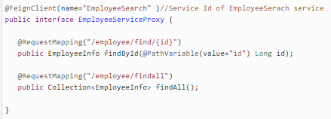
Feign Client
Step 2:

Slide 38
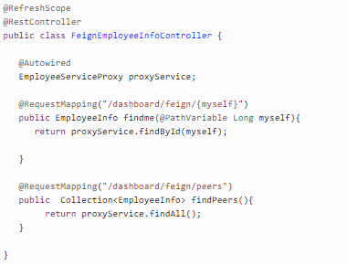
Step 3: Now we will create a FeignEmployeeInfoController where we autowire our Interface so Spring can Inject actual implementation during runtime. Then, we call that implementation to call the EmployeeService REST API.
Feign Client

Slide 39
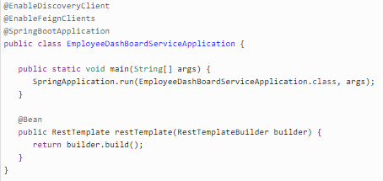
Feign Client
Step 4: we need to tell our project that we will use Feign client, so scan its annotation. For this, we need to add the @EnableFeignClients annotation on top

Slide 40
Feign Client
Examples , below are steps
(Code available in https://drive.google.com/open?id=1CxVUCI4dKsheferXDzOUPYxIt_Xj9Ivf )
#1. Run Eureka Server com.doj.discovery Main Application
#2. Run com.myfeignn.client Main Application
#3. Run com.myfeignn.server Main Application
#4. Cross check if ports are given appropriately in all application.yml files
#5. Now. Give url in Browser http://localhost:4321/
Get content like below in Browser
Hello World: HelloServer:DESKTOP-V70EGBV:3333
Service Registry/Discovery
Eureka Server
Service Registry/Discovery
Browser
FeignClient
Server

Slide 41
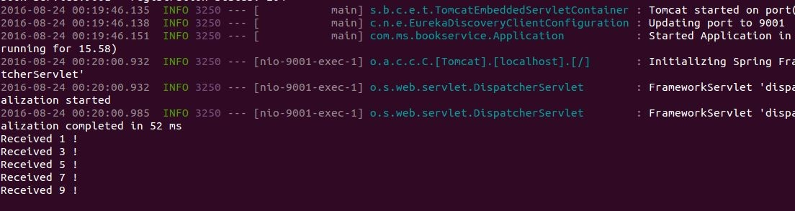
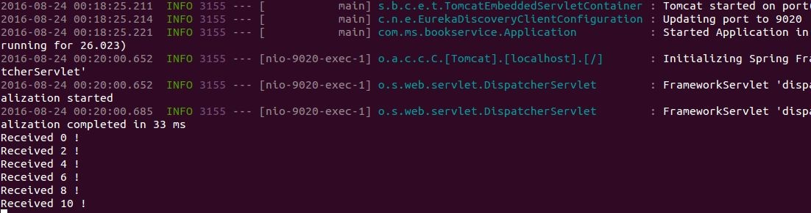
Load balancing -Ribbon

Slide 42
What is Load Balancing?
Load Balancing is the mechanism in which the incoming requests need to get distributed among all available instances of a microservice.
This improves response time, and availability(when an instance goes down during maintenance)
There are two types of Load Balancing Client side and Proxy Load Balancing.

Slide 43
Client Side Load Balancing
In Microservice environment we will be using Client Side Load Balancing Solution(Ribbon)
Why Client-side Load Balancing
No Single Point of Failure, each Client can use different Load Balancing Algorithms, One Hop less,
Implementing Client-Side Load Balancing
We will use Netflix Ribbon, it provide several algorithm for Client-Side Load Balancing. Spring provide smart RestTemplate for service discovery and load balancing by using @LoadBalanced annotation with RestTemplate instance.

Slide 44
Ribbon
Enable Ribbon in POM
<dependency>
<groupId>org.springframework.cloud</groupId>
<artifactId>spring-cloud-starter-ribbon</artifactId>
</dependency>
Enable Ribbon in Code @FeignClient(name="forex-service")
@RibbonClient(name="forex-service")
public interface CurrencyExchangeServiceProxy {
Configure the instances in application.properties:
forex-service.ribbon.listOfServers=localhost:8000,localhost:8001

Slide 45
Ribbon
Client side load balancing maintains an algorithm like round robin or zone specific, by which it can invoke instances of calling services.
The advantage is service registry always updates itself;
if one instance goes down, it removes it from its registry
so when the client side load balancer talks to the Eureka server, it always updates itself
so there is no manual intervention- unlike server side load balancing- to remove an instance.

Slide 46
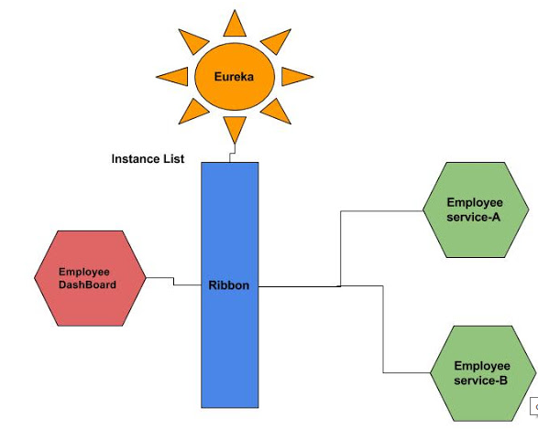
Ribbon

Slide 47
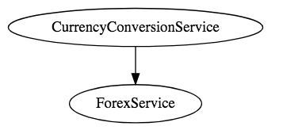
Client Side Load Balancing

Slide 48
Ribbon
Very Good overall reference:
https://bushkarl.gitbooks.io/spring-cloud/content/spring_cloud_security/more_detail.html
https://github.com/spring-cloud/spring-cloud-netflix/issues/2025
https://stackoverflow.com/questions/44402621/how-to-customize-the-ribbon-load-balancer-in-zuul-server

Slide 49
Load Balancing custom Configurations
an IClientConfig, which stores client configuration for a client or load balancer,
an ILoadBalancer, which represents a software load balancer,
a ServerList, which defines how to get a list of servers to choose from,
an IRule, which describes a load balancing strategy, and
an IPing, which says how periodic pings of a server are performed.
In our case above, the client is named say-hello. The properties we set are eureka.enabled (which we set to false), listOfServers, and ServerListRefreshInterval. Load balancers in Ribbon normally get their server lists from a Netflix Eureka service registry. (See the Service Registration and Discovery guide for information on using a Eureka service registry with Spring Cloud.) For our simple purposes here, we’re skipping Eureka, so we set the ribbon.eureka.enabled property to false and instead give Ribbon a static listOfServers. ServerListRefreshInterval is the interval, in milliseconds, between refreshes of Ribbon’s service list.

Slide 50
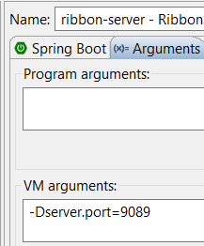
How to Run Ribbon Example
Download Example From
https://drive.google.com/open?id=1iau3Q3K2sRcrZhOxp9PSWwVrsSQvVlZ2
#1. Run ribbon-eureka-server, RibbonEurekaServerApplication.java, it’s default port number is 8761
#2. Run ribbon-client, default port number is 8889
#3. In ribbon-server, when you try to run ,
goto ‘Run Configurations…” , under Arguments,
specify, -Dserver.port=9099
Repeat Step #3, to run multiple instances with
different port numbers
#4. Now, hit the ribbon-client
http://localhost:8889/client/frontend
and observe the output, which shows details of Server Instance
which is processing current Client’s request

Slide 51
Diagrammatic Representation
Service Registry/Discovery
Ribbon Eureka Server
Service Registry/Discovery
Browser
RibbonClient
Ribbon Server
Instance1
Ribbon Server
Instance2
Ribbon Server
Instance3

Slide 52
Client Side Load Balancing Custom Class
Step 1:
@RibbonClient(name="currency-exchange-service", configuration = MyConfig.class)
Step 2:
@Configuration
public class MyConfig {
@Bean
public IRule ribbonRule() {
//return new RandomRule();
return new RoundRobinRule();
}
}
You may also create your own Logic instead of specifying existing Load Balancing Algorithms

Slide 53
Client Side Load Balancing Custom Class
Custom Rule Definition
@Bean
@Scope("prototype")
public IRule ribbonRule() {
return new PickFirstLoadBalancerRule();
}
public class PickFirstLoadBalancerRule extends AbstractLoadBalancerRule {
@Override
public void initWithNiwsConfig(IClientConfig clientConfig) {
}
@Override
public Server choose(Object key) {
List<Server> upList = getLoadBalancer().getReachableServers();
//returns the first lb in the list every time
if (upList != null && upList.size() > 0) {
return upList.get(0);
}
return null;
}}

Slide 54
RestTemplate
RestTemplate is provided by Spring Framework, and is used to invoke one Microservice from another Microservice.
For Spring boot web based projects, no extra dependency need to be added in pom.xml
And no specific configuration is required in application.yml or properties
To invoke another Microservice, object of RestTemplate need to be created and corresponding XyzForEntity() method need to be invoked. For example getForEntity().

Slide 55
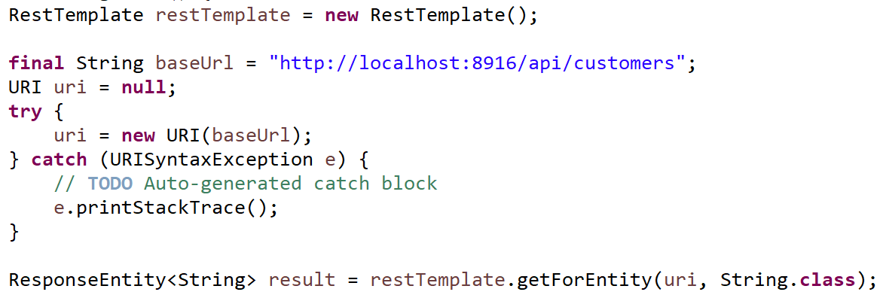
RestTemplate
RestTemplate Example below
Also it is possible to transform one HTTP method to another, for example GET to POST, etc...

Slide 56
RestTemplate
Microservice 1
Microservice 2
RestTemplate

Slide 57
Spring Cloud Config
Browser
Cloud Config Client
Cloud Config Server
apply
Configurations
Read
Configurations

Slide 58
Spring Cloud Config
One more fantastic feature provided by Spring Cloud is Cloud Config.
Advantages of Cloud Config is Configurations can be changed across all deployed and running Microservices/instances without restart.

Slide 59
Spring Cloud Config
Download Application:
https://drive.google.com/open?id=1M8Sj3tu4ku0BDTi_7yy0Aqnyy4GixZWO
Steps to run, after importing both Projects:
run server using "mvn spring-boot:run"
run client using "mvn spring-boot:run"
hit on Browser, http://localhost:8080/msg
Now make changes to development profile properties file:
git init(first time only), git add ., git commit -m "nothing"
POST http://localhost:8080/refresh from PostMan
again visit http://localhost:8080/msg and check if modified

Slide 60
Logs & Monitoring
One of the most frequently mentioned challenges related to the creation of microservices-based architecture is monitoring.
Each microservice should be run in an environment isolated from the other microservices so it does not share resources such as databases or log files with them.
Grepping the logs is not the right solution for that problem. There are some helpful tools that can be used when creating microservices with Spring Boot and Spring Cloud frameworks.

Slide 61
Logs & Monitoring
There are also some other tools — for example,
Hystrix and
Turbine — that provide real-time metrics for the requests processed by microservices.

Slide 62
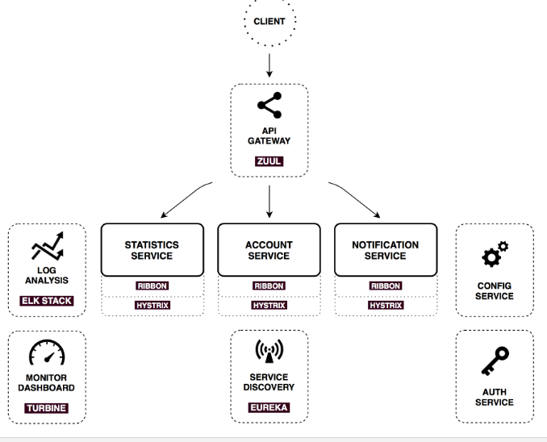
Logs & Monitoring

Slide 63
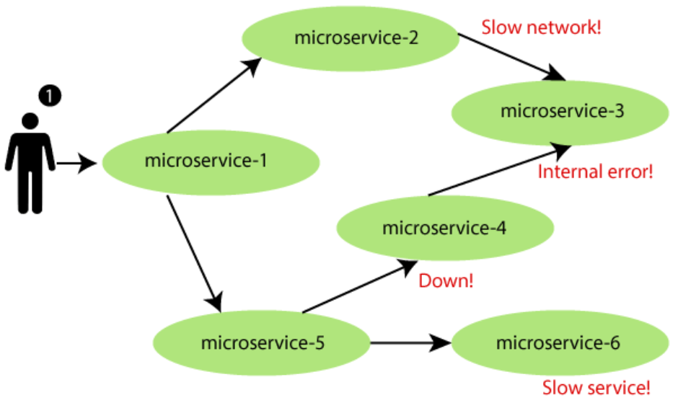
Circuit Breaker

Slide 64
Circuit Breaker - Hystrix
Since Microservices have multiple interactions between various Services, there can be some interaction issues or slow network, etc…
A feature called Circuit Breaker is provided to takecare of such breakages. Whenever such breakages are detected, a fallback method is invoked instead of hitting the same resource multiple times, this reduces resources consumption. A standby or fallback takescare of the situation.
For example, consider that we are interacting with Stock Exchange to retrieve current price of a Company, if its temporarily down, this data can be retrieved from local sources such as our DB or else where.
This improves reliability, fault tolerance.

Slide 65
Hystrix
Hystrix Dashboard can be used to view if any Circuits are open
Below are steps to use Hystrix in Microservice Architecture
Step 1: Add the Spring-Cloud-Starter-hystrix:
<dependency>
<groupId>org.springframework.cloud</groupId>
<artifactId>spring-cloud-starter-hystrix</artifactId>
</dependency>

Slide 66
Hystrix
Step 2: Enable Hystrix support for the Application, this will expose the hystrix stream at a "/hystrix.stream" uri:
@SpringBootApplication
@EnableHystrix
public class SpringCloudApp {
public static void main(String[] args) {
SpringApplication.run(SpringCloudApp.class, args);
}
}
Now for the Hystrix Dashboard application to graphically view the Hystrix stream, the following annotation will enable that and the application should be available at "/hystrix" uri:
@SpringBootApplication

Slide 67
Hystrix
@SpringBootApplication
@EnableHystrixDashboard
public class AggregateApp {
public static void main(String[] args) {
SpringApplication.run(AggregateApp.class, args);
}
}

Slide 68
Hystrix Example
Download the Application from: https://drive.google.com/open?id=1dtQDnvPM2RuPuvbA2u-jmamo09hkF3xZ
#1. Run the Project, after importing into STS IDE
#2. Open URL in Browser http://localhost:8829/hystrix, in text box enter http://localhost:8829/actuator/hystrix.stream
#3. Start hitting the url http://localhost:8829/rest/hello from Browser multiple times, observe that , sometimes it fails
#4. Whenever it fails(#3), observe a spike in the graph opened in Step above #2.

Slide 69
How to improve Fault Tolerance
What happens when a Eureka Server instance goes down?
What happens when Zuul Gateway instance goes down?
Can our Microservice ecosystem continue to serve requests from client even in above scenarios?
Answer is YES, it’s possible by having multiple instances of Eureka Server or Zuul Gateways running

Slide 70
Turbine
<dependency>
<groupId>org.springframework.cloud</groupId>
<artifactId>spring-cloud-starter-turbine</artifactId>
<exclusions>
<exclusion>
<groupId>javax.servlet</groupId>
<artifactId>servlet-api</artifactId>
</exclusion>
</exclusions>
</dependency>
And to enable Turbine support in a Spring Boot based application:
Configurations for Turbine:
turbine:
aggregator:
clusterConfig: SAMPLE-HYSTRIX-AGGREGATE
appConfig: SAMPLE-HYSTRIX-AGGREGATE

Slide 71
Turbine
cluster is available at "/turbine.stream?cluster=SAMPLE-HYSTRIX-AGGREGATE" uri, it would figure out the instances of the cluster using Eureka, source the Hystrix stream from each instance and aggregat

Slide 72
Contract Testing
What is Contract?
Why should we worry about Contract?
How to check that, if Contract is intact between releases
Perform Contract Testing
Contract Testing plays Vital role in SOftware Systems with huge number of Services interacting with each other

Slide 73
Break Monolithic to Microservice Architecture
Is it Mandatory to break/decompose a big Monolithic into Microservice Architecture, if not what can be side effects. Does it affect business? https://martinfowler.com/articles/break-monolith-into-microservices.html
It would be overhead to break a small software system into Microservices.
Decomposition Plan & estimate cost associated
It will take multiple iterations
Get basic infrastructure ready for Microservice Architecture

Slide 74
Break Monolithic to Microservice Architecture
Get one by one business capability out of Monolithic System, based on dependencies, release flexibility, etc…
Minimize dependency back to Monolithic System, but the reverse is fine.

Slide 75
Break Monolithic to Microservice Architecture
Consider in a retail online system, where ‘buy’ and ‘promotions’ are core capabilities. ‘buy’ uses ‘promotions’ during the checkout process to offer the customers the best promotions that they qualify for, given the items they are buying. If we need to decide which of these two capabilities to decouple next, I suggest to start with decoupling ‘promotions’ first and then 'buy'. Because in this order we reduce the dependencies back to the monolith. In this order ‘buy’ first remains locked in the monolith with a dependency out to the new ‘promotions’ microservice.

Slide 76
Break Monolithic to Microservice Architecture
Identify the most coupling concept and decouple, deconstruct and reify into concrete domain services
Code refactoring may be required within Monolithic System, before making it as a separate Service
Macro and then Micro
----
How to deal with Entities, Model, Respositories, Services?

Slide 77
Multi Tenant Architecture
What Is Multi-tenancy?
Multi-tenancy is an architecture in which a single instance of a software application serves multiple customers. Each customer is called a tenant. Tenants may be given the ability to customize some parts of the application, such as the color of the user interface (UI) or business rules, but they cannot customize the application’s code.
We can implement multi-tenancy using any of the following approaches:
Database per Tenant: Each Tenant has its own database and is isolated from other tenants.
Shared Database, Shared Schema: All Tenants share a database and tables. Every table has a Column with the Tenant Identifier, that shows the owner of the row.
Shared Database, Separate Schema: All Tenants share a database, but have their own database schemas and tables.

Slide 78
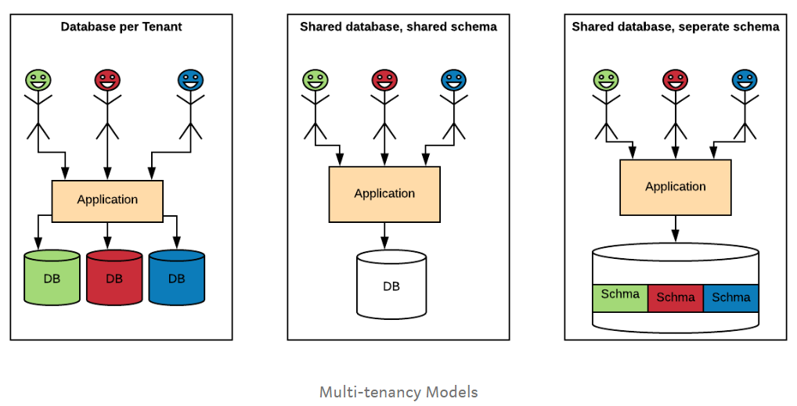
Multi Tenant Architecture

Slide 79
REST API Versioning
REST API versioning can be avoided, if possible, by ensuring that single version provides backward compatibility, to keep old consumers running.
Following factors affect the choice of versioning:
URI Pollution — URL versions and Request Param versioning pollute the URI space.
Misuse of HTTP Headers — Accept Header is not designed to be used for versioning.
Caching — If you use Header based versioning, we cannot cache just based on the URL. You would need to take the specific header into consideration.
Can we execute the request on the browser? — If you have non-technical consumers, then the URL based version would be easier to use as they can be executed directly on the browser.
API Documentation — How do you get your documentation generation to understand that two different URLs are versions of the same service?

Slide 80
12 Factor App Principles & Purpose
https://dzone.com/articles/12-factors-and-beyond-in-java

